Slide 1

ANNUAL GLOBAL MEETING 2020
“Clinic session”:
Participation of persons with disabilities in CCCM responses

Slide 2
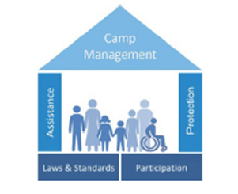
“Nothing about us, without us”
– Disability community motto

Slide 3
Selected take-aways from the Participation session
- Part 1
Participation, accountability and inclusion are not linear processes – they are complex, interconnected, and need to be contextualized
People remain at the center of our actions, in their complexity and diversity
Intersectionality: persons are diverse in their identities, age, gender, experiences, abilities, hopes and aspirations
Accountable to whom? Camp leaders and rep only?
Participation as a right, not an obligation

Slide 4
Selected take-aways - Part 2
CFMs: how can data support inclusion; how can we capture the use of CFMs by persons with disabilities; how can we make sure CFMs are accessible; how can we respond and close the loop?
HI training package
IRC Disability Inclusive Client Responsiveness project
The need for partnerships – OPDs and more
UNDIS Guidelines on consultation with OPDs

Slide 5
Selected take-aways – end
Persons with mental and psychosocial impairments among the most marginalized – what can we do?
IASC Guidelines on MHPSS – What CCCM actors should know?
The need to create more space for people to engage with CM actors, and support their engagement with pre-existing structures at camp level

Slide 6
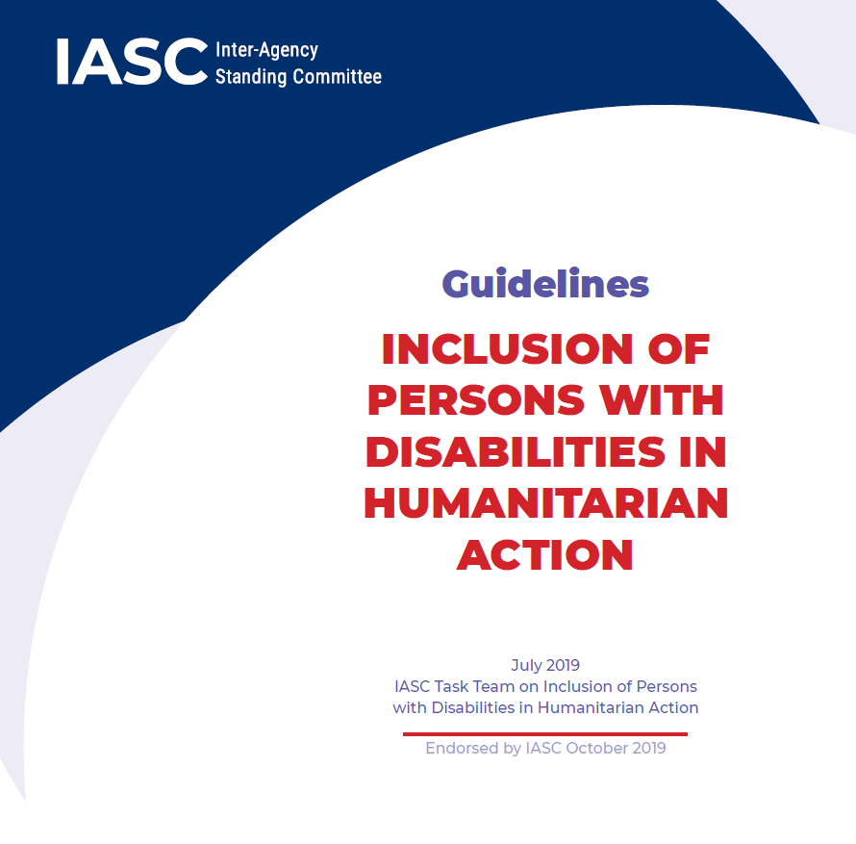
IOM Guidance note and tools to support the inclusion and participation of persons with disabilities in CCCM responses
Derived from the IASC Guidelines on disability inclusion
Aligned with the Global CCCM Cluster Working Group on Participation in displacement
Operational
Geared towards partnership
Focus on the « How to »

Slide 7
Examples of tools:
Tips on communicating with people with different types of impairments
How to involve persons with disabilities in the identification of barriers and enablers
Examples of selected methodologies such as accessibility audits
Guidance on Inclusive Information, Education and Communication (IEC) materials.
Lessons’ learnt on the establishment of disability committees
Recommendations on accessible CFMs
Checklist for monitoring

Slide 8
For further information about the guidance note, to contribute to the development or review of the note and tools, or for any other suggestions:
Contact: atillinac@iom.int
Also, keep on the discussion by joining the Global Cluster WG on Participation in Displacement!

